Slide 1

Constructing the Dicke States on a Quantum Computer
Yannick Bergs
Technische Universität München
TUM School of Muster
Lehrstuhl für Muster
München, 13. Dezember 2024

Slide 2
Introduction to Quantum Many Body Physics

Slide 3

Quantum Many Body Physics: Motivation
Models systems with multiple particles that exhibit quantum nature.
Machinery of Quantum Mechanics often only used in microscopic environments
BUT: Composite Systems can give rise to macroscopic properties unexplained by classical material physics [1]:
Superconductivity
Thermalization
…
Floating Superconductor [2]

Slide 4

Quantum Many Body Physics: Motivation
Modeling macroscopic structures is computationally infeazible (for classical machines).
Example:
40 particles with 4 excitation levels and no further restrictions
In general the time evolution operator $e^{−iHt}$ has $4^{{40}^{2}}=2^{160}$ complex entries.
For comparison: Earth has approx. $2^{160}$ atoms.

Slide 5
Quantum Many Body Physics: Motivation
Modeling macroscopic structures is computationally infeazible (for classical machines).
Solution:
Study toy models that have symmetries reducing the number of free components.
Concrete example:
Restricted entanglement, i.e. there has to be a basis in which two subsystems have low entanglement entropy
More on that later…

Slide 6
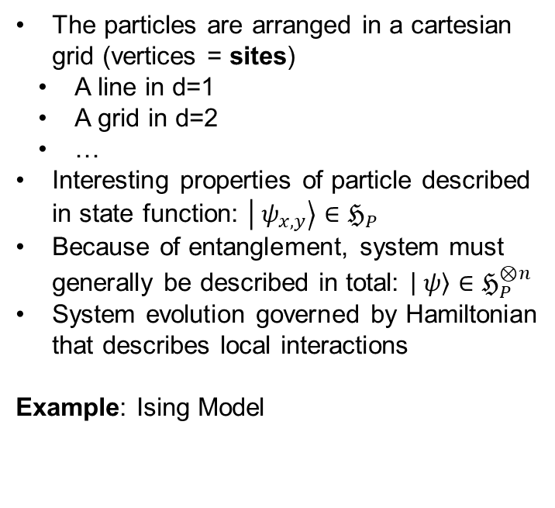
Quantum Many Body Physics: Lattice Model
A common simplification of real materials are Lattice Models.
The particles are arranged in a cartesian grid (vertices = sites)
A line in d=1
A grid in d=2
…
Interesting properties of particle described in state function: $\left| ψ_{x, y}\right\rangle ∈ℌ_{P}$
Because of entanglement, system must generally be described in total: $\left| ψ\right\rangle ∈ℌ_{P}^{⊗n}$
System evolution governed by Hamiltonian that describes local interactions
Example: Ising Model

Slide 7
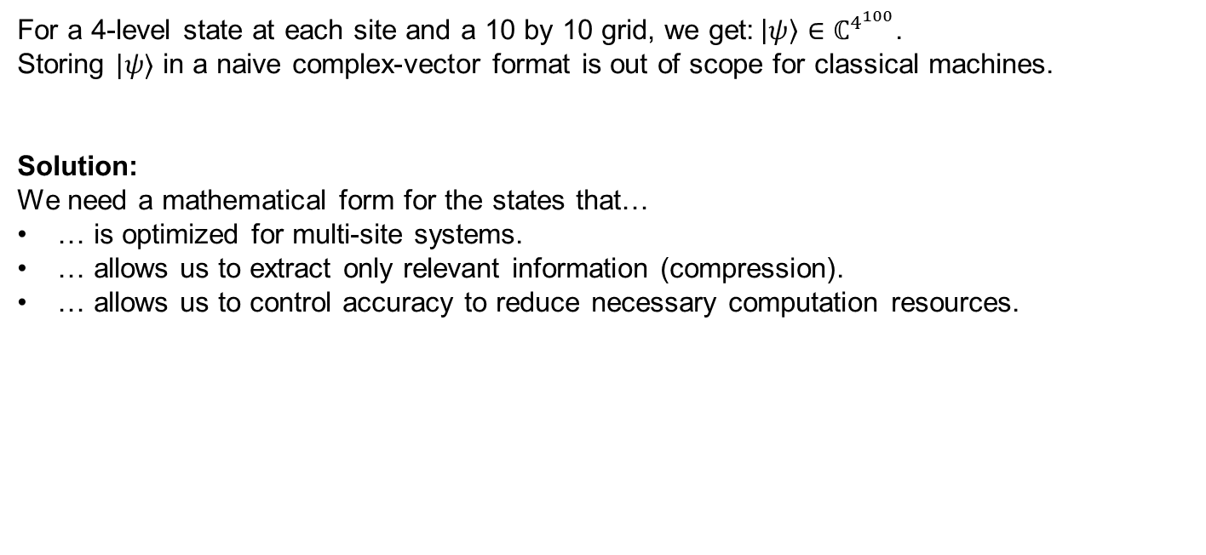
Quantum Many Body Physics: Lattice Model
Caviat:
Just using this model does not grant computational benefits.
For a 4-level state at each site and a 10 by 10 grid, we get:$\left|ψ\right\rangle ∈ℂ^{4^{100}}$.
Storing $|ψ⟩$ in a naive complex-vector format is out of scope for classical machines.
Solution:
We need a mathematical form for the states that…
… is optimized for multi-site systems.
… allows us to extract only relevant information (compression).
… allows us to control accuracy to reduce necessary computation resources.

Slide 8
Tensor Networks and Matrix Product States

Slide 9
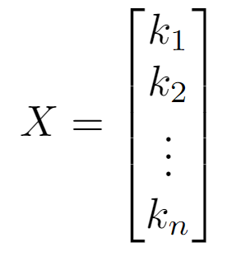
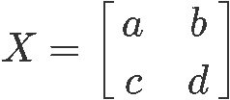

Tensor Networks: Fundamentals
The mathematical framework for optimized state-vector representations are Tensor Networks.
Key question: What are tensors?
From a computer-scientist perspective:
Tensors are N-dimensional arrays that support a mathematical operation called contraction.
They are characterized by their degree, i.e. the number of indices and the dimension of each index.
$$X=i$$
Tensor of degree 0
(3)-Tensor
(2,2)-Tensor

Slide 10

Tensor Networks: Fundamentals
Tensors are visualized with legs for each index which can be labeled for clarity.
When legs of tensors are connected a contraction is applied to get the complete tensor.
A tensor $A_{i, j, k}$ of degree 3 is visualized with three open legs (left).
A composite tensor $X_{a, b, j, k}=\sum_{s}{Y_{a, b, s}}Z_{s, j, k}$ is visualized with a connected leg (right).
X
i
a
k
A
s
k
j
Y
Z
b
j

Slide 11
Tensor Networks: Fundamentals
Tensors can be reshaped by merging or splitting indices.
Commonly tensors are matricized or vectorized to make use of LA tools.
Example:
A contraction along two legs is calculated as a matrix-vector multiplication:
mat(A)
vec(B)
i
i
A
i*j
B
k
j
j

Slide 12
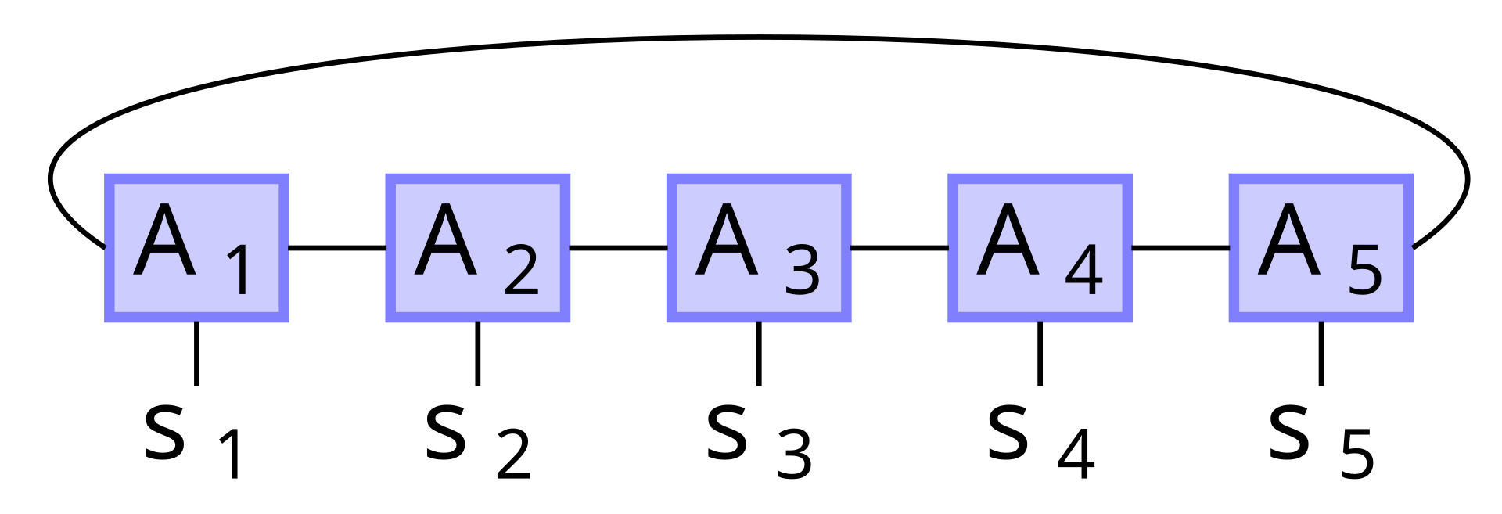


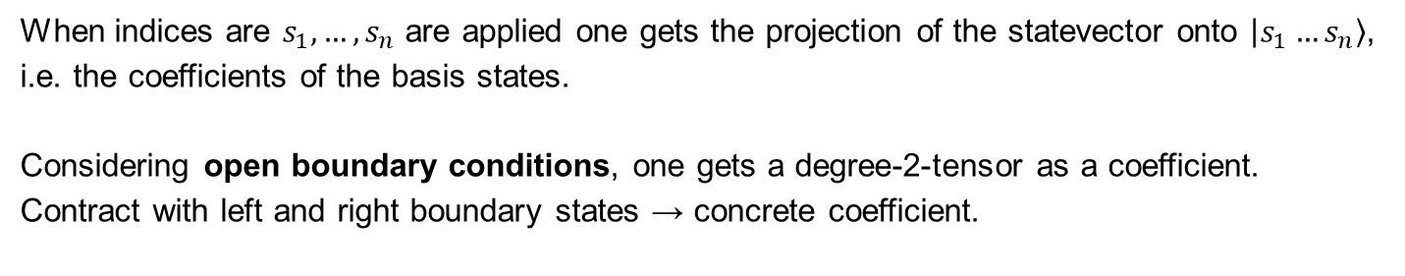
Tensor Networks: Matrix Product States (MPS)
Representation of quantum states with $n$ sites that have $d_{j}$ excitation levels.
The statevector index is split into site-local indices.
When indices are $s_{1}, …, s_{n}$ are applied one gets the projection of the statevector onto $\left|s_{1}…s_{n}\right\rangle$, i.e. the coefficients of the basis states.
Considering open boundary conditions, one gets a degree-2-tensor as a coefficient.
Contract with left and right boundary states → concrete coefficient.
$$⟨L|$$
$$|R⟩$$

Slide 13
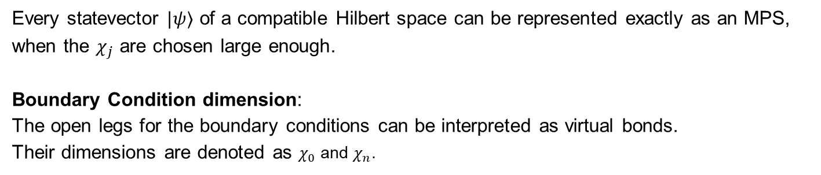
Tensor Networks: Matrix Product States (MPS)
The spatial complexity of a MPS can be controlled using the virtual bond dimensions $χ_{j}$.
Every statevector $|ψ⟩$ of a compatible Hilbert space can be represented exactly as an MPS, when the $χ_{j}$ are chosen large enough.
Boundary Condition dimension:
The open legs for the boundary conditions can be interpreted as virtual bonds.
Their dimensions are denoted as $χ_{0}$ and $χ_{n}$.
$$⟨L|$$
$$|R⟩$$

Slide 14
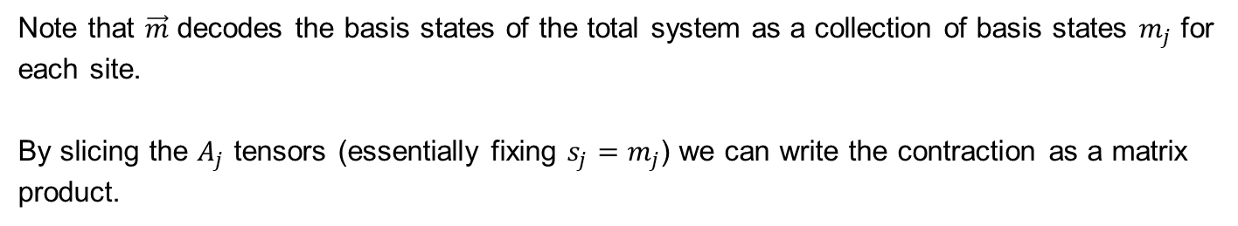
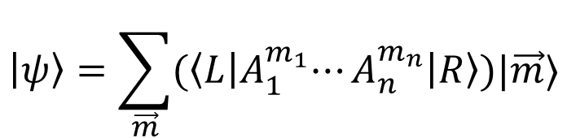
Tensor Networks: Matrix Product States (MPS)
Using slices of the degree-3-tensors one can write the MPS in symbolic form.
$$\left|ψ\right\rangle =\sum_{\vec{m}}{{(\left\langle L\right|A}_{1}^{m_{1}}⋯A_{n}^{m_{n}}\left|R\right\rangle )|\vec{m}⟩}$$
Note that $\vec{m}$ decodes the basis states of the total system as a collection of basis states $m_{j}$ for each site.
By slicing the $A_{j}$ tensors (essentially fixing $s_{j}=m_{j}$) we can write the contraction as a matrix product.

Slide 15
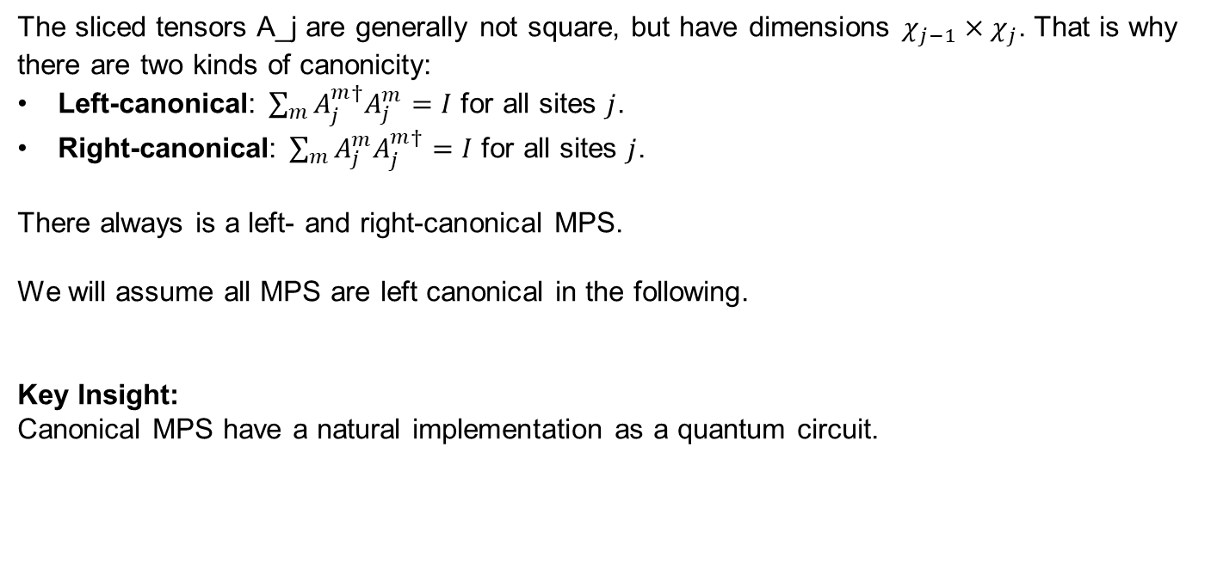
Tensor Networks: Canonical MPS
A form of tensor networks that leads to many computational simplifications.
The sliced tensors A_j are generally not square, but have dimensions $χ_{j−1}×χ_{j}$. That is why there are two kinds of canonicity:
Left-canonical: $\sum_{m}{A_{j}^{m†}A_{j}^{m}=I}$ for all sites $j$.
Right-canonical: $\sum_{m}{A_{j}^{m}A_{j}^{m†}=I}$ for all sites $j$.
There always is a left- and right-canonical MPS.
We will assume all MPS are left canonical in the following.
Key Insight:
Canonical MPS have a natural implementation as a quantum circuit.

Slide 16
Quantum Circuit for (almost) Canonical MPS

Slide 17






Quantum Circuit: Qudits
Generalization of Qubits to physical systems with $d$ computational basis states.
Each site of the MPS can be modelled as a system qudit with $d_{j}=\dim{s_{j}}$:
$q_{1}$: $d_{1}$-level qudit
$q_{2}$: $d_{2}$-level qudit
$q_{3}$: $d_{3}$-level qudit
$q_{4}$: $d_{4}$-level qudit
$q_{5}$: $d_{5}$-level qudit

Slide 18






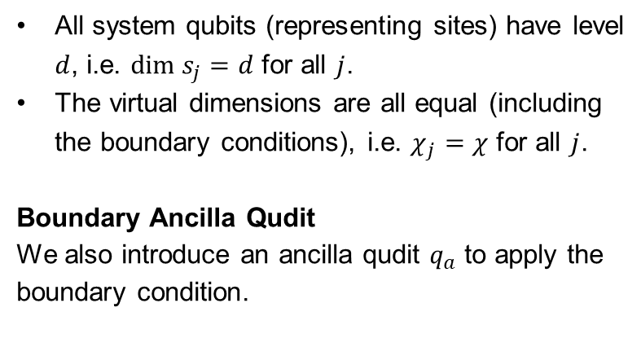
Quantum Circuit: Simplifying Assumptions
For our final purpose (implementing Dicke States) we can simplify our MPS model.
All system qubits (representing sites) have level $d$, i.e. $dim s_{j}=d$ for all $j$.
The virtual dimensions are all equal (including the boundary conditions), i.e. $χ_{j}=χ$ for all $j$.
Boundary Ancilla Qudit
We also introduce an ancilla qudit $q_{a}$ to apply the boundary condition.
$q_{1}$: $d_{1}$-level qudit
$q_{2}$: $d_{2}$-level qudit
$q_{3}$: $d_{3}$-level qudit
$q_{4}$: $d_{4}$-level qudit
$q_{5}$: $d_{5}$-level qudit
$q_{a}$: $χ$-level qudit

Slide 19
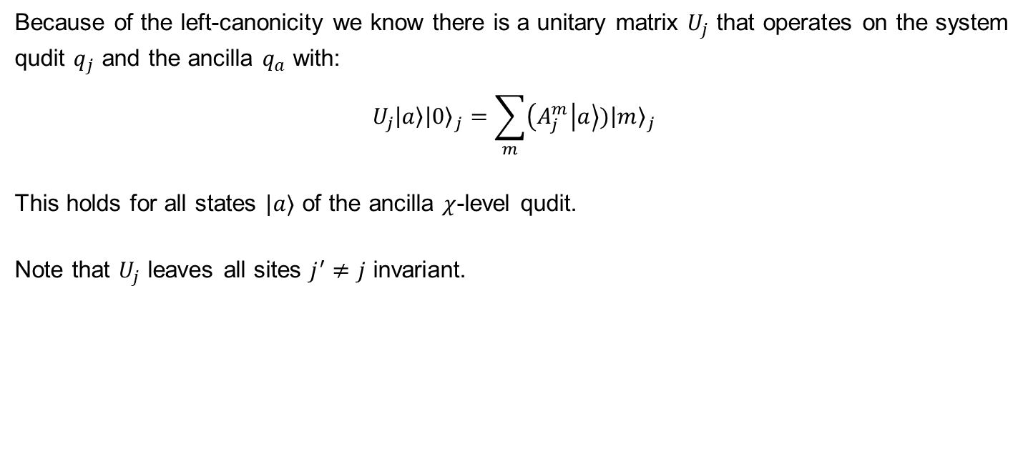
Quantum Circuit: Unitary representation of $A_{j}$
The action of each of the site-specific tensor can be represented as a unitary quantum gate form.
Because of the left-canonicity we know there is a unitary matrix $U_{j}$ that operates on the system qudit $q_{j}$ and the ancilla $q_{a}$ with:
$$U_{j}\left|a\right\rangle {\left|0\right\rangle }_{j}=\sum_{m}{\left(A_{j}^{m} | a\right\rangle ){\left|m\right\rangle }_{j}}$$
This holds for all states $|a⟩$ of the ancilla $χ$-level qudit.
Note that $U_{j}$ leaves all sites $j^{′}≠j$ invariant.

Slide 20
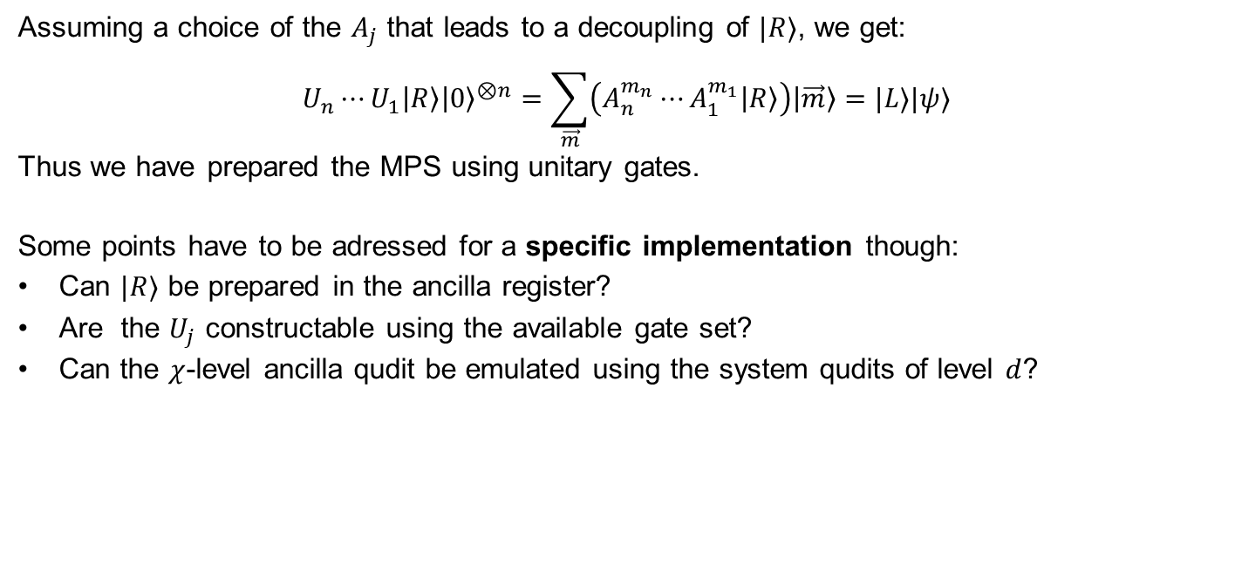
Quantum Circuit: Preparation of $|ψ⟩$
Chaining the unitaries leads to a preparation circuit for the MPS $|ψ⟩$.
Assuming a choice of the $A_{j}$ that leads to a decoupling of $|R⟩$, we get:
$$U_{n}⋯U_{1}\left|R\right\rangle {\left|0\right\rangle }^{⊗n}=\sum_{\vec{m}}{\left(A_{n}^{m_{n}}⋯A_{1}^{m_{1}}\left|R\right\rangle \right)\left|\vec{m}\right\rangle }=|L⟩|ψ⟩$$
Thus we have prepared the MPS using unitary gates.
Some points have to be adressed for a specific implementation though:
Can $|R⟩$ be prepared in the ancilla register?
Are the $U_{j}$ constructable using the available gate set?
Can the $χ$-level ancilla qudit be emulated using the system qudits of level $d$?

Slide 21

Quantum Circuit: Almost Canonical MPS
The requirement for the MPS of $|ψ⟩$ to be left-canonical is more strict then necessary.
It is enough to have any MPS where the $U_{j}$ are unitary and perform the mapping described earlier.
The following construction for the Dicke State MPS will only be „almost canonical“.

Slide 22
Quantum Circuit for Dicke State Preparation

Slide 23
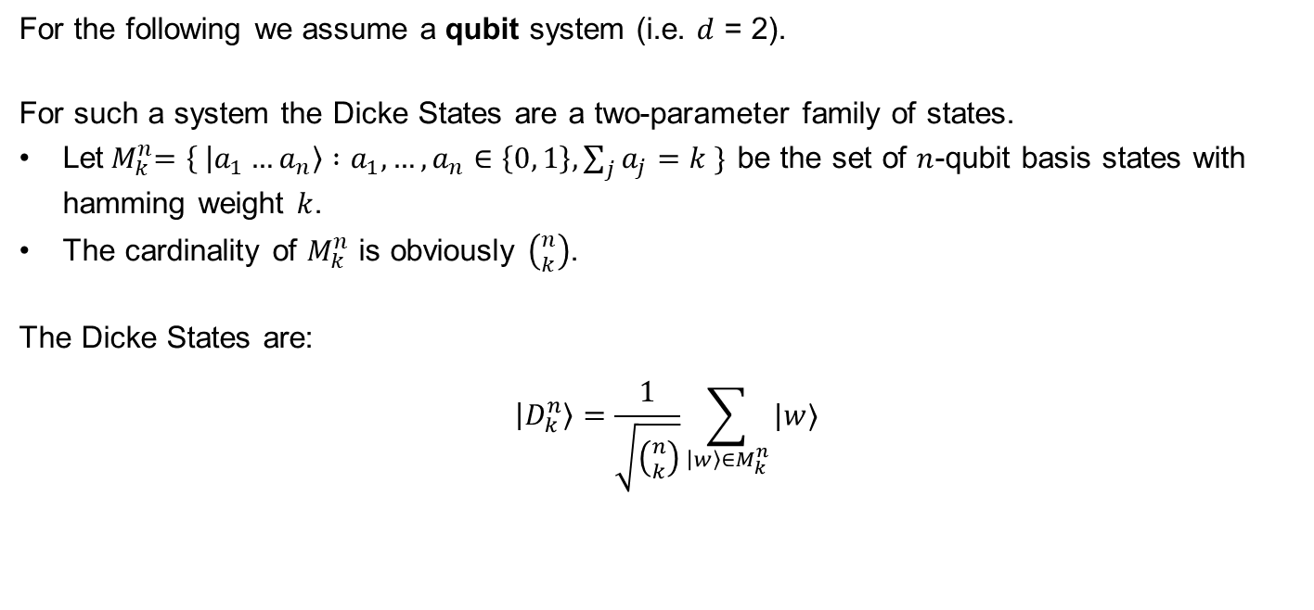
Dicke States: Definition
The Dicke states are equal superposition states of basis states with equal hamming weight.
For the following we assume a qubit system (i.e. $d$ = 2).
For such a system the Dicke States are a two-parameter family of states.
Let${ M}_{k}^{n}=\left\{ | a_{1}…a_{n}\right\rangle :a_{1}, …,a_{n}∈\left\{0, 1\right\}, \sum_{j}{a_{j}}=k \}$ be the set of $n$-qubit basis states with hamming weight $k$.
The cardinality of $M_{k}^{n}$ is obviously $\left({n \atop k}\right)$.
The Dicke States are:
$$\left|D_{k}^{n}\right\rangle =\frac{1}{\sqrt{\left({n \atop k}\right)}}\sum_{\left|w\right\rangle ∈M_{k}^{n}}{|w⟩}$$

Slide 24
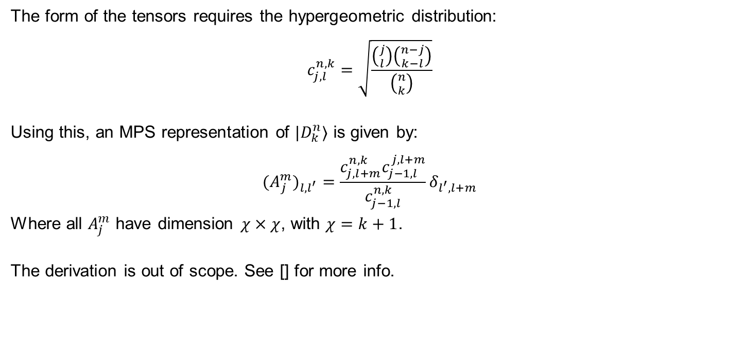
Dicke States: MPS Representation
There exists an „almost canonical“ MPS representation of Dicke States.
The form of the tensors requires the hypergeometric distribution:
$$c_{j,l}^{n,k}=\sqrt{\frac{\left({j \atop l}\right)\left({n−j \atop k−l}\right)}{\left({n \atop k}\right)}}$$
Using this, an MPS representation of $|D_{k}^{n}⟩$ is given by:
$${{(A}_{j}^{m})}_{l, l^{′}}={\frac{c_{j, l+m}^{n,k}c_{j−1, l}^{j,l+m}}{c_{j−1,l}^{n,k}}δ}_{l^{′}, l+m}$$
Where all $A_{j}^{m}$ have dimension $χ×χ$, with $χ=k+1$.
The derivation is out of scope. See [] for more info.

Slide 25

Dicke States: $U_{j}$-Operators
The almost-canonicity allows us to create unitary gates to implement the Dicke States, as described for general canonical MPS.
We need operators U_j that fulfill the mapping:
$$U_{j}\left|a\right\rangle {\left|0\right\rangle }_{j}=\sum_{m}{\left(A_{j}^{m} | a\right\rangle ){\left|m\right\rangle }_{j}}$$
Ansatz:
Build U_j from simpler operators:
$$U_{j}=\prod_{l=k}^{l=0}{I_{l}^{(j)}}$$

Slide 26









Dicke States: $I_{l}^{(j)}$-Operators
Perform the mapping for $\left|a\right\rangle =|l⟩$ and leave other states invariant using a conditional $y$-rotation on the site qubit $q_{j}$.
The circuit for the operator rotates by an angle $θ$ with:
$$θ_{l}=2\arccos{γ_{l, 0}^{j}}, γ_{l, 0}^{j}=\left\{\begin{aligned}\sqrt{1+ \frac{l−k}{n−j+1}}, \text{if} k−l≤n−j+1 \\ &0, \text{else}\end{aligned}\right.$$
$$q_{j}$$
$$0$$
$$R_{Y}(θ_{l})$$
$$0$$
$$q_{a}$$
$$⊕$$
$$l+1$$
$$⊖$$

Slide 27

Dicke States: $I_{l}^{(j)}$-Operators
The partial operators perform conditional $y$-rotations on each site qubit.
The $⊕$ and $⊖$ operate on the auxiliary qudit and map:
$$⊕:\left|a\right\rangle ↦|a+1 \text{mod} χ⟩$$
$$⊖:\left|a\right\rangle ↦|a−1 \text{mod} χ⟩$$
$$q_{j}$$
$$0$$
$$R_{Y}(θ_{l})$$
$$0$$
$$q_{a}$$
$$⊕$$
$$l+1$$
$$⊖$$

Slide 28

Dicke States: Restricted $U_{j}$-Operators
The product construction of $U_{j}$ can thus be restricted to only relevant terms.
Observation:
Many $I_{l}^{(j)}$-operators simplify to the identity or cancel out.
Keeping only relevant term, the restricted form of $U_{j}$ becomes:
$$U_{j}=\prod_{l=\min{(j−1, k−1)}}^{l=\max{(0, j−n+k−1)}}{I_{l}}$$

Slide 29
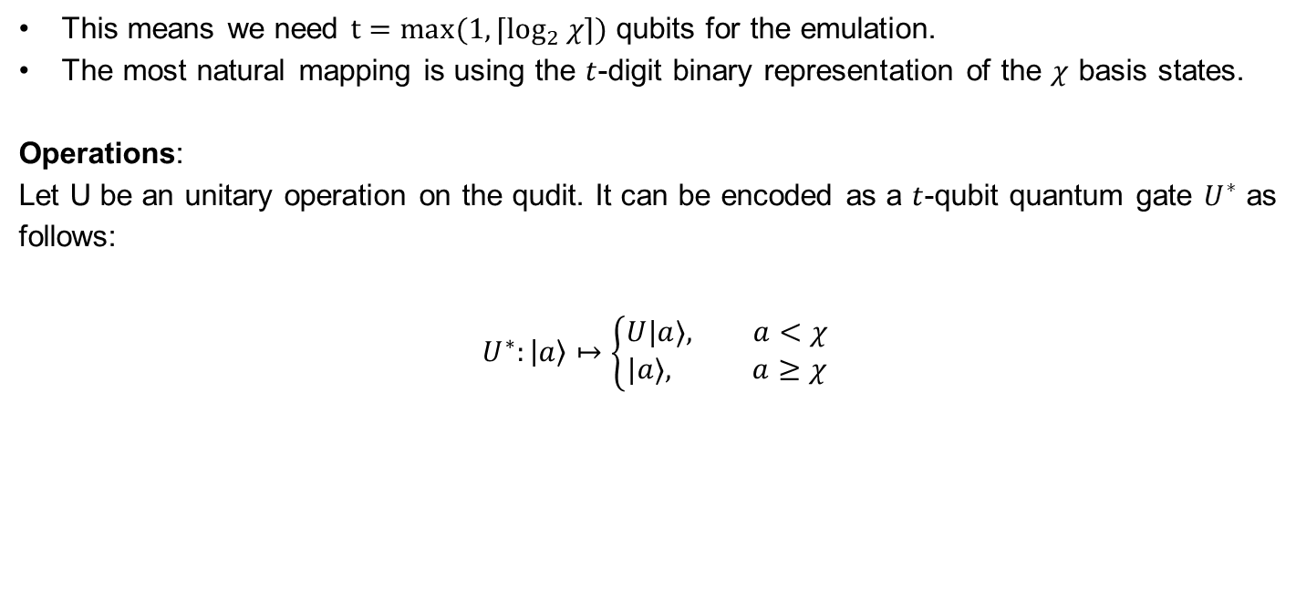
Dicke States: Emulating the $χ$-level Qudit
A qubit register can be used to emulate a $χ$-level qudit, if we can identify $χ$ distinct basis states.
This means we need ${t=max(1, ⌈log}_{2}{χ}⌉)$ qubits for the emulation.
The most natural mapping is using the $t$-digit binary representation of the $χ$ basis states.
Operations:
Let U be an unitary operation on the qudit. It can be encoded as a $t$-qubit quantum gate $U^{∗}$ as follows:
$$U^{∗}:\left|a\right\rangle ↦\left\{\begin{aligned}U|a⟩, a<χ \\ &|a⟩, a≥χ\end{aligned}\right.$$

Slide 30

Dicke States: Circuit Complexity
We assume $⊕$, $⊖$, $c^{n}R_{Y}$ operations are supported natively by our quantum computer for now.
Circuit Depth:
Considering the restricted construction of the $U_{j}$:
$$n_{\text{layers}}=3k\left(n+1−k\right)$$
Qubit Count:
Including the emulated qudit:
$$n_{\text{qubits}}=n+\max{(1, \left\lceil \log_{2}{k+1}\right\rceil )}$$

Slide 31
Concrete Examples for $n=2$

Slide 32
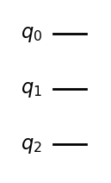

Concrete Example: $|D_{0}^{2}⟩$
$${\left|0\right\rangle }_{a}{\left|0\right\rangle }_{1}{\left|0\right\rangle }_{0}={\left|0\right\rangle }_{a}|D_{0}^{2}⟩$$

Slide 33
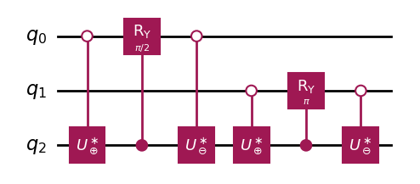





Concrete Example: $|D_{1}^{2}⟩$
$$2^{−1/2}{\left|1\right\rangle }_{a}({\left|1\right\rangle }_{1}{\left|0\right\rangle }_{0}+{{\left|0\right\rangle }_{1}\left|1\right\rangle }_{0})$$
$$2^{−1/2}{(\left|0\right\rangle }_{a}{\left|0\right\rangle }_{1}{\left|0\right\rangle }_{0}+{{\left|1 \right\rangle }_{a}{\left|0\right\rangle }_{1}\left|1\right\rangle }_{0})$$
$$={\left|1\right\rangle }_{a}|D_{1}^{2}⟩$$
$$2^{−1/2}{\left|1\right\rangle }_{a}{\left|0\right\rangle }_{1}{(\left|0\right\rangle }_{0}+{\left|1\right\rangle }_{0})$$
$$2^{−1/2}{(\left|1\right\rangle }_{a}{\left|1\right\rangle }_{1}{\left|0\right\rangle }_{0}+{{\left|0\right\rangle }_{a}{\left|0\right\rangle }_{1}\left|1\right\rangle }_{0})$$

Slide 34
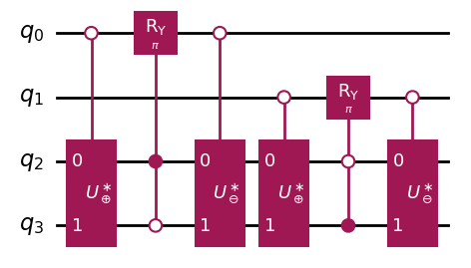


Concrete Example: $|D_{2}^{2}⟩$
$${\left|1\right\rangle }_{a}{\left|0\right\rangle }_{1}{\left|1\right\rangle }_{0}$$
$${\left|2\right\rangle }_{a}{\left|1\right\rangle }_{1}{\left|1\right\rangle }_{0}={\left|k\right\rangle }_{a}|D_{2}^{2}⟩$$

Slide 35
Decomposition into Primitive Gates

Slide 36
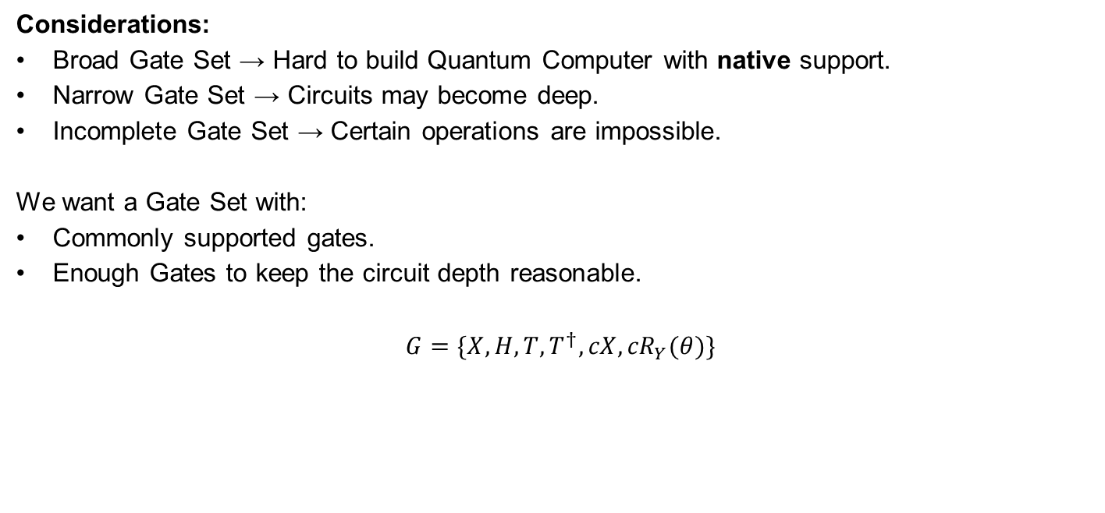
Decomposition: Primitive Gate Set
The primitive gate set contains operations that are expected to be implemented in the physical system.
Considerations:
Broad Gate Set → Hard to build Quantum Computer with native support.
Narrow Gate Set → Circuits may become deep.
Incomplete Gate Set → Certain operations are impossible.
We want a Gate Set with:
Commonly supported gates.
Enough Gates to keep the circuit depth reasonable.
$$G=\{X, H,T,T^{†},{cX,cR}_{Y}(θ)\}$$

Slide 37

Decomposition: Procedure
Reduce the entire circuit to primitive gates.
Ripple Down:
Decompose circuit from most abstract to most concrete.
All encountered gates are decomposed.
Decompositions are potentially further simplified.
We start with the $I_{l}^{(j)}$-Operators.

Slide 38









Decomposition: $I_{l}^{(j)}$-Operator
Non-Primitive Gates:
$c⊕$ and $c⊖$
$c^{n}R_{Y}(θ)$
Note that we have a $cR_{Y}\left(θ\right)$ gate in the primitive gate set, but need a multi-controlled version.
The increment/decrement operators also require further investigation.
$$q_{j}$$
$$0$$
$$R_{Y}(θ_{l})$$
$$0$$
$$q_{a}$$
$$⊕$$
$$l+1$$
$$⊖$$

Slide 39
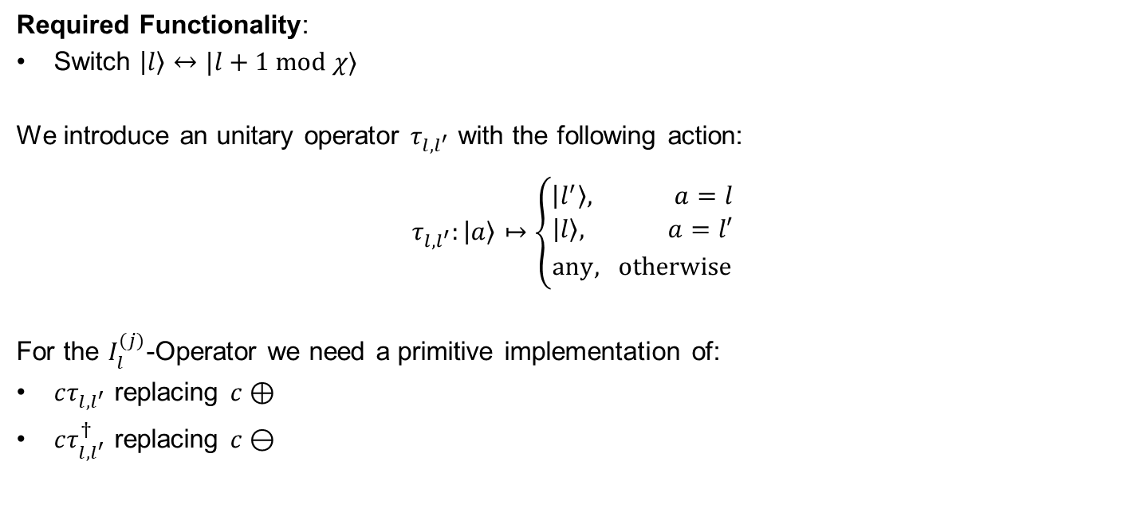
Decomposition: $I_{l}^{(j)}$-Operator, Simplification
The $⊕$ and $⊖$ provide a lot of unused functionality that makes them complex. These can be simplified.
Required Functionality:
Switch $\left|l\right\rangle ↔|l+1 \text{mod} χ⟩$
We introduce an unitary operator $τ_{l,l^{′}}$ with the following action:
$$τ_{l,l^{′}}:\left|a\right\rangle ↦\left\{\begin{aligned}\left|l^{′}\right\rangle , a=l \\ &{\left|l\right\rangle , a=l′ \atop \text{any}, \text{otherwise}}\end{aligned}\right.$$
For the $I_{l}^{(j)}$-Operator we need a primitive implementation of:
$cτ_{l,l^{′}}$ replacing $c⊕$
$cτ_{l,l^{′}}^{†}$ replacing $c⊖$

Slide 40
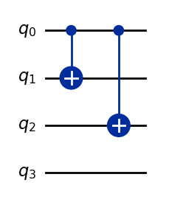

Decomposition: $cτ_{l,l^{′}}$-Operator
The $τ_{l,l^{′}}$-Operator can be implemented by introducing $X$-gates at all mismatching positions of $l$ and $l′$ in binary form.
For the controlled version, we replace $X$-gates with $cX$-gates controlled by the control qubit.
Example:
An example for:
$l=3=011$
$l^{′}=0=000$
This gate is also its own inverse.

Slide 41


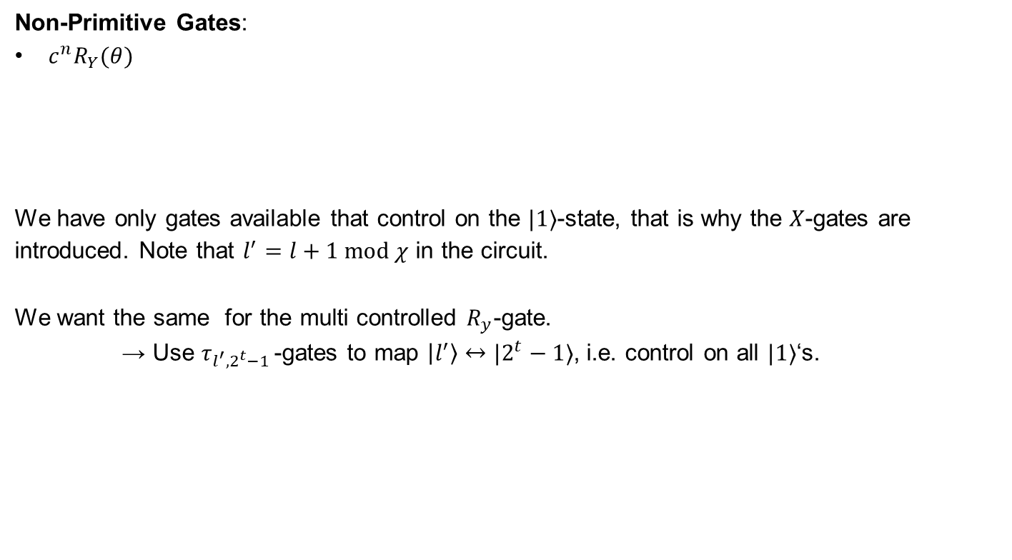





Decomposition: $I_{l}^{(j)}$-Operator, Current State
Non-Primitive Gates:
$c^{n}R_{Y}(θ)$
We have only gates available that control on the $|1⟩$-state, that is why the $X$-gates are introduced. Note that $l^{′}=l+1 \text{mod} χ$ in the circuit.
We want the same for the multi controlled $R_{y}$-gate.
→ Use $τ_{l^{′},2^{t}−1 }$-gates to map $\left|l^{′}\right\rangle ↔|2^{t}−1⟩$, i.e. control on all $|1⟩$‘s.
$$q_{j}$$
$$X$$
$$X$$
$$R_{Y}(θ_{l})$$
$$X$$
$$X$$
$$q_{a}$$
$$τ_{l,l^{′}}$$
$$l+1$$
$$τ_{l,l^{′}}$$
$$X$$

Slide 42



Decomposition: $I_{l}^{(j)}$-Operator, Current State
Non-Primitive Gates:
$c^{n}R_{Y}(θ)$
The $R_{y}$-gate is now controlled on all $|1⟩$‘s. Note that ${η=2}^{t}−1$.
All that is left is to actually implement the $c^{n}R_{Y}(θ)$-gate using primitives.
$$q_{j}$$
$$X$$
$$X$$
$$R_{Y}(θ_{l})$$
$$X$$
$$X$$
$$q_{a}$$
$$τ_{l,l^{′}}$$
$$τ_{l^{′},η }$$
$$τ_{l^{′},η }$$
$$τ_{l,l^{′}}$$
$$X$$

Slide 43
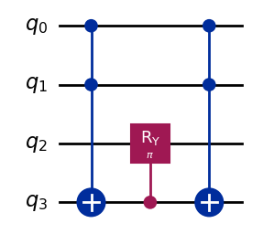

Decomposition: $c^{n}R_{Y}(θ)$-Operator
To keep the implementation of this operator simple, we introduce a clean ancilla qubit.
We store the result of the condition in the ancilla qubit, and then use a $cR_{Y}(θ)$-gate.
Example:
An example for:
$n=2$
$θ=π$
$q_{3}$ being the ancilla qubit.
Non-Primitive Gates:
$c^{n}X$

Slide 44
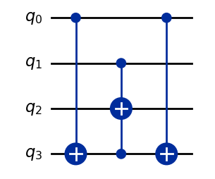
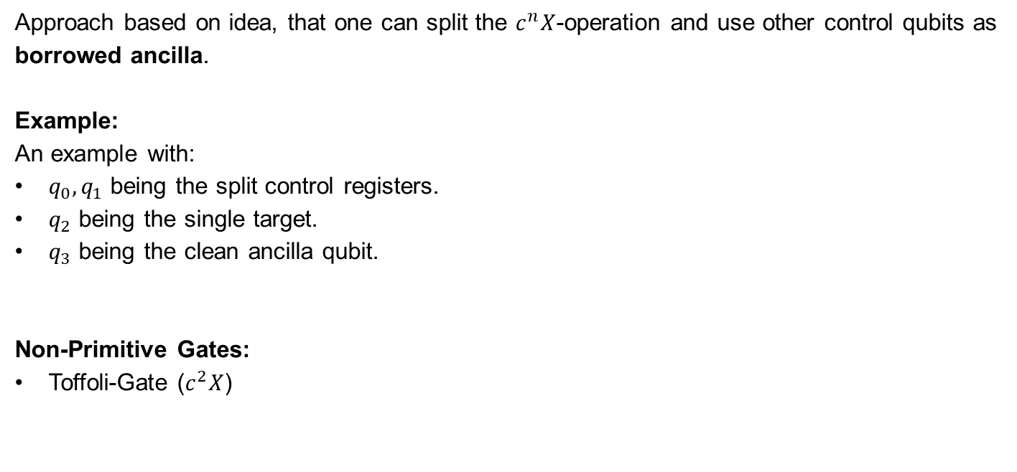
Decomposition: $c^{n}X$-Operator
Following the approach from [] we can construct a $c^{n}X$-gate using one clean ancilla and Toffoli gates.
Approach based on idea, that one can split the $c^{n}X$-operation and use other control qubits as borrowed ancilla.
Example:
An example with:
$q_{0},q_{1}$ being the split control registers.
$q_{2}$ being the single target.
$q_{3}$ being the clean ancilla qubit.
Non-Primitive Gates:
Toffoli-Gate ($c^{2}X$)

Slide 45
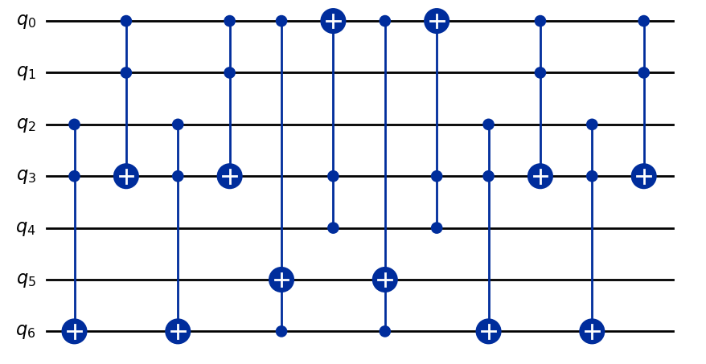



Decomposition: $c^{5}X$ Example
$$c^{5}$$
$$q_{\text{target}}$$
$$q_{\text{ancilla}}$$

Slide 46
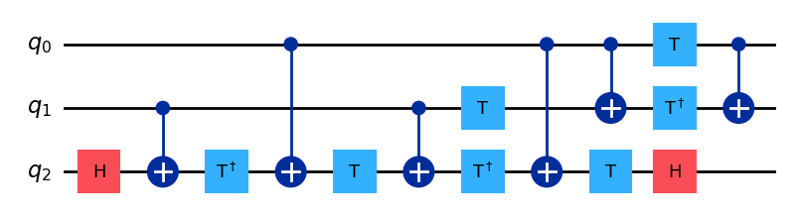
Decomposition: Toffoli-Gate
The Toffoli gate has a well-known decomposition only containing primitive gates.

Slide 47
Decomposition: Results
We are able to completely decompose the circuit into our Primitive Gate Set, generally requiring 2 ancilla qubits.
We of course pay with circuit depth:
Dicke State | Abstract Layers | Primitive Layers

Slide 48
Thank you, Any questions left?

Slide 49
References
[1]: Website: Max-Plank-Institute of QPO (https://www.mpq.mpg.de/6497440/many-body-physics)

